Slide 1
SRS to ADVISER
Record Breakdown

Slide 2
ADVISER Resources
ADVISER Data Elements pdf can be found on the NDE website under ADVISER Data Guidance.
Notes:
Everything talked about in this presentation except for how to fix errors in SRS can be found in resources provided by NDE

Slide 3
What generates an ADVISER record to be published in SRS?
Finalization of IEP/IEP Card when the following conditions are met
Finalized MDT/MDT Card
State ID saved on Student Info page
Reactivation of student’s account that had previously been exited from SPED
Old data published to ADVISER if any finalized MDT and IEP is on file
Save Edit Student page
When ADVISER record fails to generate even when IEP and MDT are finalized
No change to data needed, just click Save
Manual creation of ADVISER Record

Slide 4
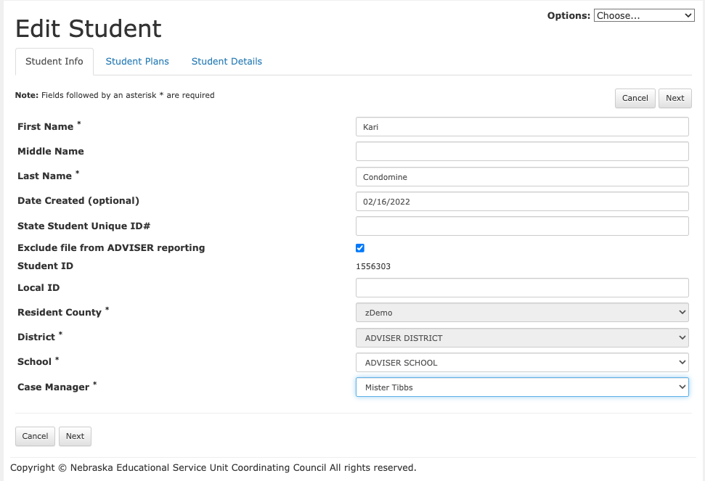
Edit Student Page

Slide 5
Requirements needed before SPED records can publish
State ID
Demographic Information
Special Program Enrollment if Early Childhood

Slide 6
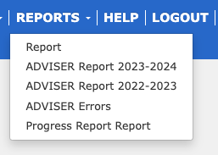
Accessing ADVISER reports
Notes:
Navigating to ADVISER reports

Slide 7
ADVISER Records
Sample
Slide
A
B
C
D
E
F
G
H
Click on the links A-I to move to the associated slides
I
Notes:
What things looked like last year

Slide 8
BEGIN DATE (ADVISER Data Elements pdf)
Return to record sample slide
When an IEP comes into effect (a student begins receiving SPED services within the given ADVISER reporting period)
OR
07/01/20XX if the IEP came into effect the previous school year
Pulled from Page 1 of IEP

Slide 9
EXIT DATE (ADVISER Data Elements pdf)
Return to record sample slide
When a student exits Special Education
OR
When a student’s IEP expires (always accompanied by SPED99 Exit Reason and a new ADVISER record)
Comes from Edit Student page if student is exiting from SPED
OR
Calculated from Meeting Date of new IEP if student is placed on new IEP

Slide 10
EXIT REASON (ADVISER Data Elements pdf)
Return to record sample slide
A code describing the reason a student exited Special Education
SPED99 means the student’s SPED records were updated (example - a new IEP conference)
Comes from Edit Student page
OR
SPED99 automatically entered when a new IEP is finalized

Slide 11
SPECIAL ED SETTING (ADVISER Data Elements pdf)
Return to record sample slide
The general education setting of a student in Special Education
Comes from Page 6 of IEP

Slide 12
LEVEL OF PROGRAM PARTICIPATION (ADVISER Data Elements pdf)
Return to record sample slide
Whether a student is in IDEA Part B or IDEA Part C
IDEA Part B = IEP
IDEA Part C = IFSP
Automatically determined by SRS based on whether data comes from an IEP or IFSP

Slide 13
PLACEMENT TYPE (ADVISER Data Elements pdf)
Return to record sample slide
Describes the condition of a student’s non-public placement
0 = Not applicable, student does not attend a non-public school (public school)
2 = Student’s non-public placement was determined by someone other than the parents (the IEP team or state)
3 = Student’s non-public placement determined by parents and is on an IEP
4 = Student’s non-public placement determined by parents and is on an Equitable Service Plan
Comes from Edit Student page

Slide 14
PLACEMENT TYPE INTERACTION WITH SETTING (ADVISER Data Elements pdf)
Return to record sample slide
If Placement Type = 2, 3, or 4 Then Special Education Setting must = 5, 7, or 14
5 = “Public School”
7 = “Residential Facility”
14 = “Private School or Exempt (Home) School”
Most students are public school students and will have Placement Type = 0
Most non-public school students will have their Placement Type = 3
Most common Setting Code for non-public students = 14

Slide 15
TO TAKE ALTERNATE ASSESSMENT (ADVISER Data Elements pdf)
Return to record sample slide
Whether or not a student takes alternate assessment
If multiple records are published, all should match “Yes” or “No” - not one “Yes” and “No”
Comes from the Edit Student page which can only be changed when an IEP or IEP Card gets finalized

Slide 16
DISABILITY (ADVISER Data Elements pdf)
Return to record sample slide
Pulled from the student’s most recent, finalized MDT where they verified with a disability
When MDT and IEP conferences are held concurrently, the wrong disability might get reported if verification has changed and the IEP gets finalized first
Comes from most recent finalized MDT

Slide 17
SPEECH THERAPY/OT/PT (ADVISER Data Elements pdf)
Return to record sample slide
Whether or not a student receives any or all of these
Speech/Language
Occupational Therapy
Physical Therapy
Comes from Page 6 of the IEP where services are detailed

Slide 18
SRS and ADVISER Tools
Opens the IEP/MDT in a new tab where data is pulled from for an ADVISER record
Opens the student’s Edit Student page in a new tab
Allows you to edit the contents of an ADVISER record
Removes the ADVISER record from the ADVISER database
Republishes data to ADVISER

Slide 19
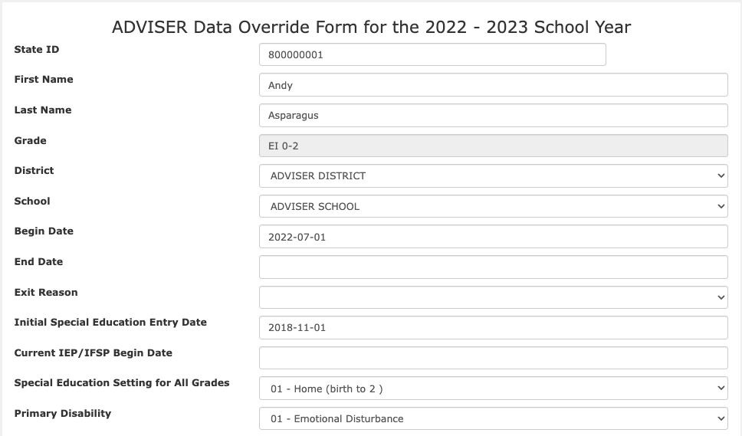
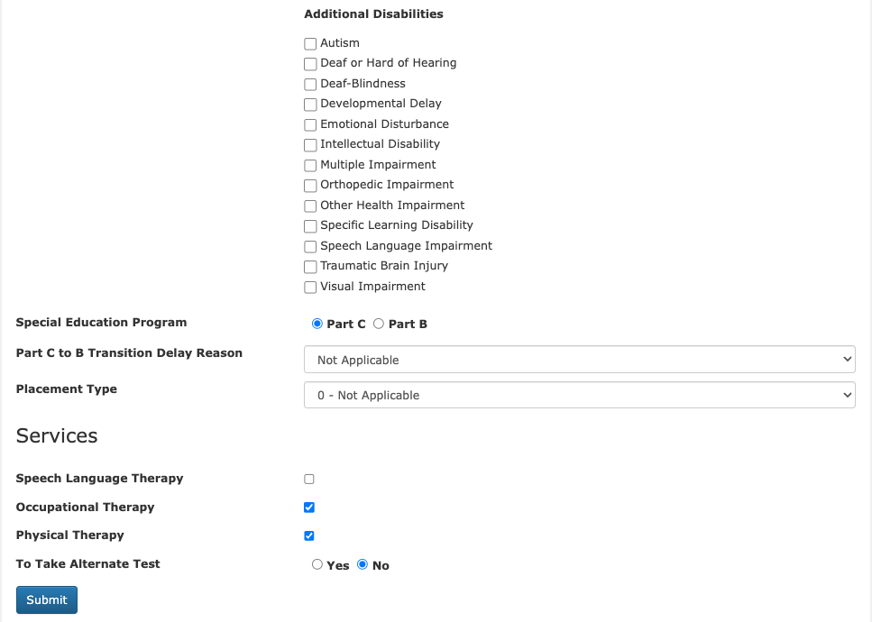
Override Page
Edit the data fields as needed and submit
3
1
2
1 Filled from Initial IEP – Previously at bottom of override list
2 Need from Current Finalized IEP / IFSP
3 New Additional Disabilities to add as needed

Slide 20
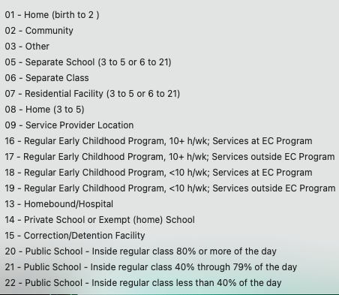
SPED Settings
Edit the data field as needed and submit

Slide 21
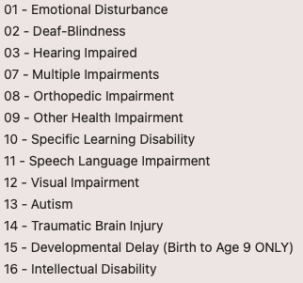
Primary Disability
Edit the data field as needed and submit

Slide 22
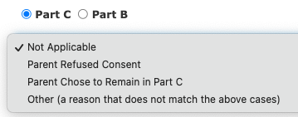
Special Education Program
Part C to B
Transition Delay
Reason:
Add reason for Early Childhood not moving to School Age

Slide 23
Placement Type
Edit the data field as needed and submit

Slide 24
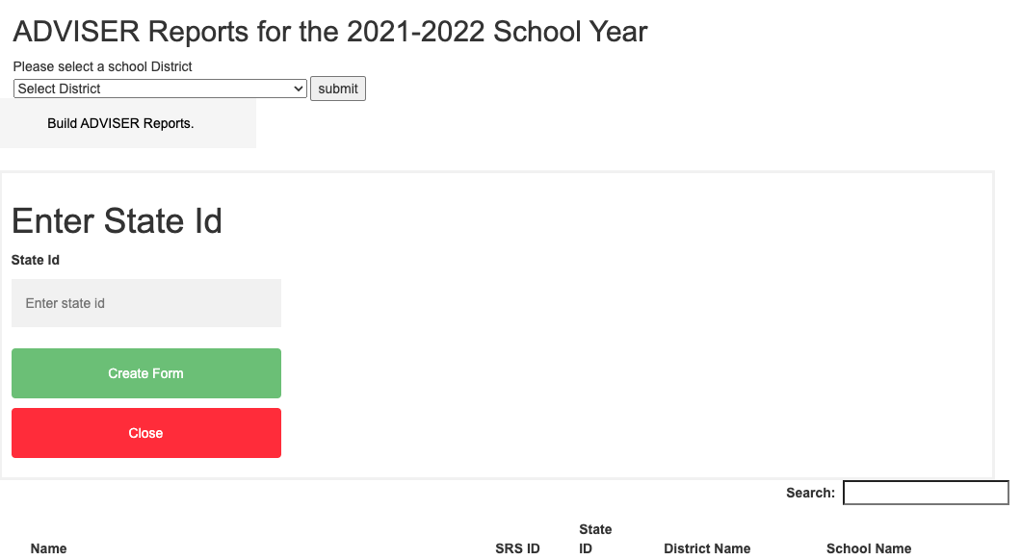
Manually Add an ADVISER Record
Add record to report
Edit as needed if not all of the data is brought over from SRS

Slide 25
The SRS Team
Scott Isaacson
Technology Director
Rita McKinney
Helpdesk and Communications Specialist
Contact Us: srshelp@esucc.org OR (402) 597-4994
Notes:
Introduce SRS team

Slide 26
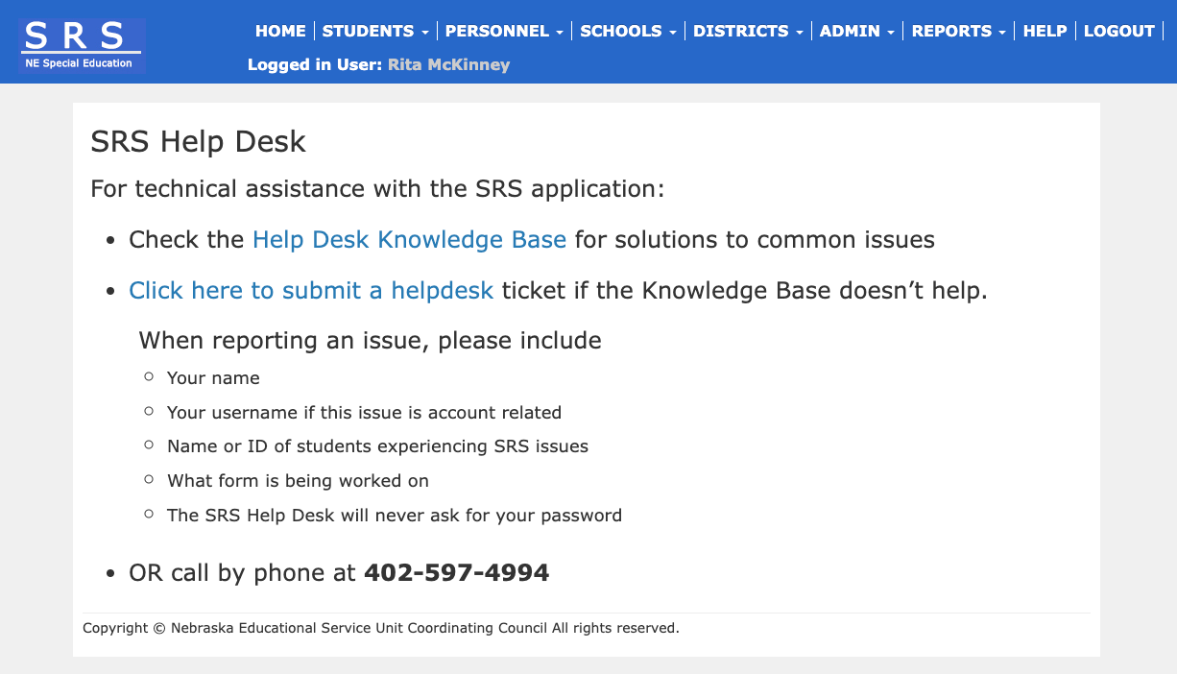

Slide 27
Contact Us
srshelp@esucc.org
or
(402) 597-4994

